Slide 1

I-Focus
Group 10-11 Samuel Leong 4S1(17)
Ryan Tan 4S1(21)
Walter Kong 4O3(33)
Xiao Songyuan 4S2(20)

Slide 2
Introduction
Notes:
The advent of mobile devices have revolutionised the way websites and interfaces are designed.
When we talk about user satisfaction, there are two important aspects.
One, the interface design. Some keywords are "responsive design" and the recent "material design".
Two, the interaction with the interface.
In our project, we take a relook on how we can best interact with our devices daily using the latest technology.
Good morning fellow judges and schoolmates. I am Walter.
Today, we're excited to share with you the findings of our research done with DSO and the implications of it.

Slide 3

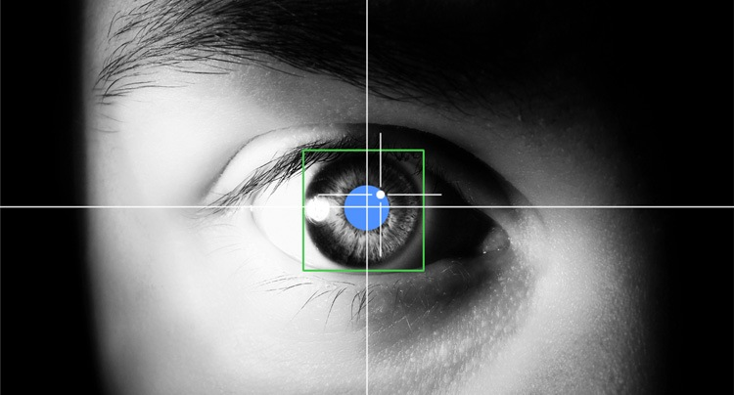
EFFICIENT.
Effective.
INTUITIVE.
Eye-tracking Look at where you want the cursor to move.
Multi-modal Input Eye-tracking + Click
Notes:
Before we begin, let us define some terms that we will be using alot.
Eye-tracking, refers to the cursor moving to where you look at.
and Multi-modal Input refers to a combination of different input forms, such as hand gesture, mouse or eye.

Slide 4
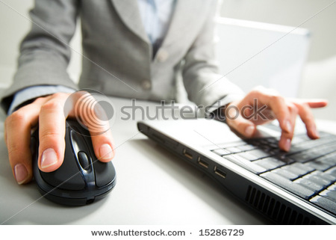
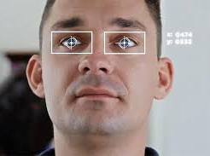
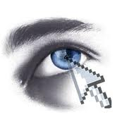

Why I-Focus?
Notes:
By experimenting with different multimodal approaches, we found the most natural way of interaction.
This is because the mouse isn't optimal for every function.

Slide 5

Target Audience
Physically Disabled
General Public
Notes:
Our project can potentially help physically disabled persons use a hands-free approach.
And it also contributes to the revolution of how we interact with our devices.
Songyuan will be sharing more on our method.

Slide 6


Objectives
DSO

Slide 7
Methodology

Slide 8
Methodology
Application
Research
Improvements

Slide 9
Timeline
Prelim Presentation
Semis Presentation
Finals Presentation
Prelim
Semis
Finals
Planning
Developmental
Implementation
Alpha Testing
Beta Testing
Extensions
Notes:
So, this was our proposed timeline and we are pleased to say we have completed most of our project!
Now, ready to see what we have done so far?

Slide 10
Application
Notes:
…presenting to you the application component of I-Focus

Slide 11



Input methods
Keyboard & Mouse
Eye-tracking (eye gestures)
Leap motion (hand gestures)
Notes:
These are the various input methods used in our project

Slide 12
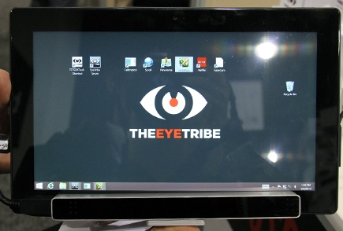
Devices
EyeTribe Eye-Tracker
Affordable · Accurate
Notes:
The device we would be using is the EyeTribe eye-tracker, which is affordable and a lot more accurate than webcams.

Slide 13
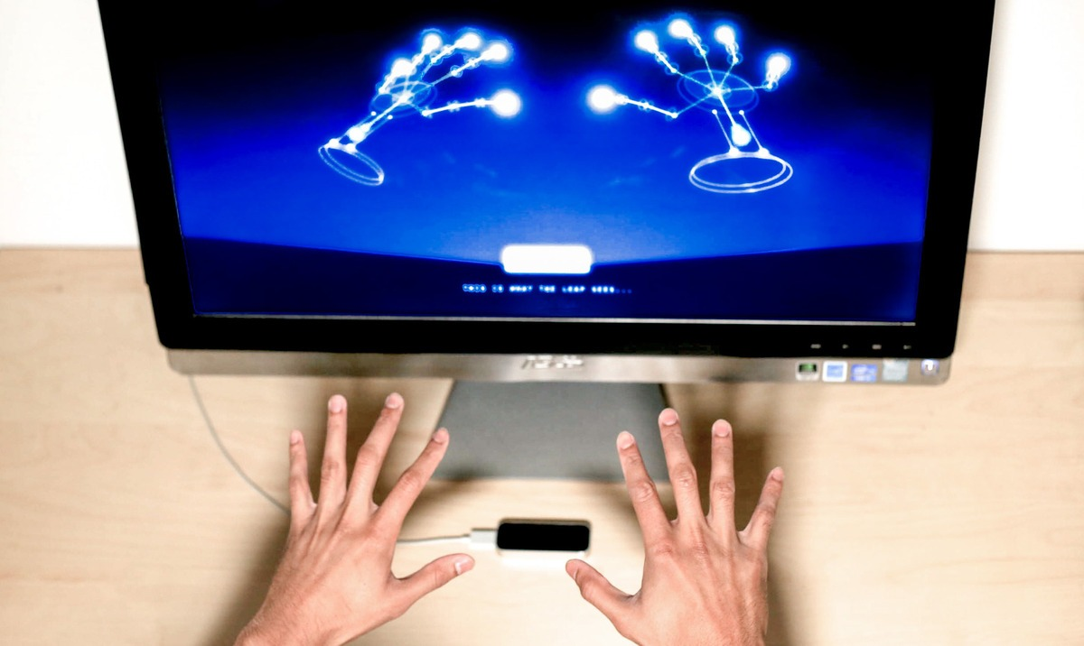
Devices
Leap Motion Hand Gestures
Physical Input
Notes:
The leap motion device is a device that tracks hand gestures and is used to sense physical input.

Slide 14
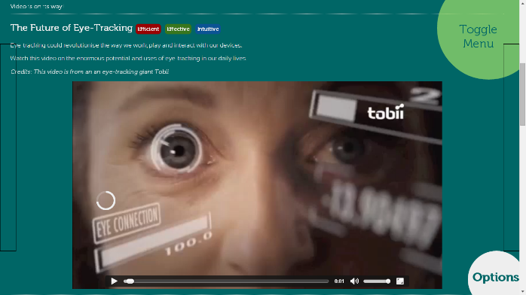
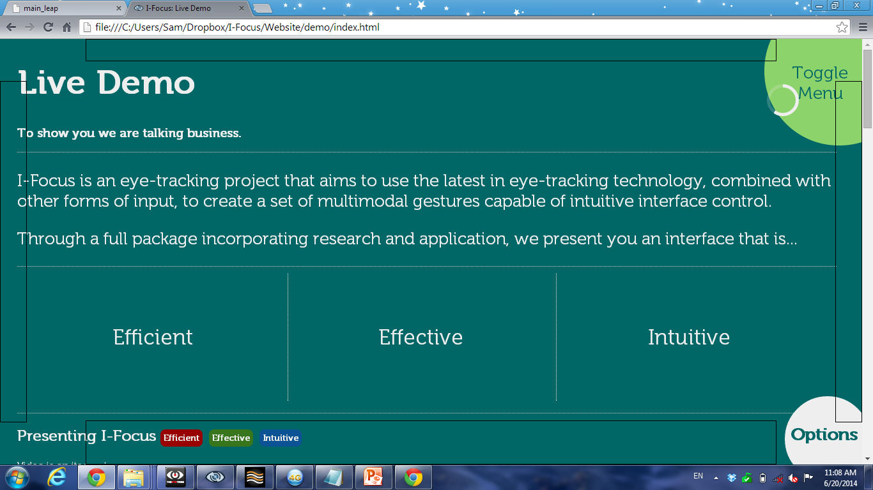
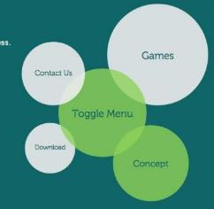
Features
Auto-scrolling
Modified Cursor
Video Control
Radial Menu
Notes:
So now for the most exciting part of the presentation… Seeing I-Focus in action…
Some of I-Focus’ features include an intuitive way to click, scroll, control videos and navigate..

Slide 15
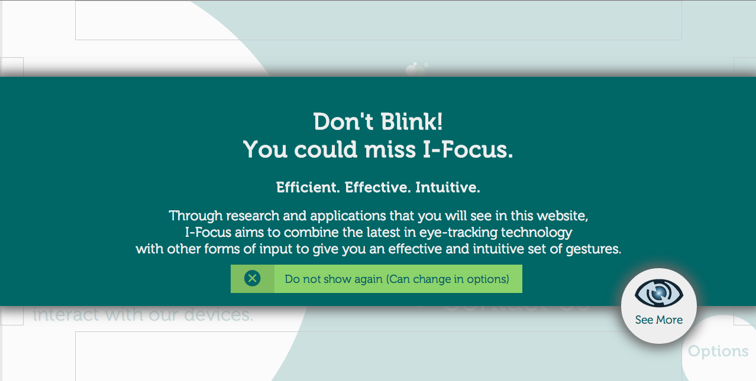
Screenshots

Slide 16
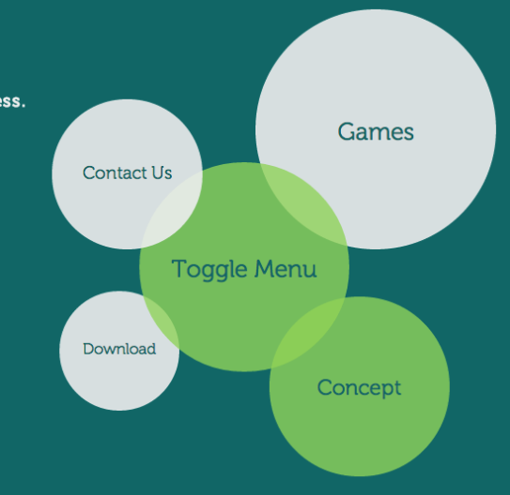
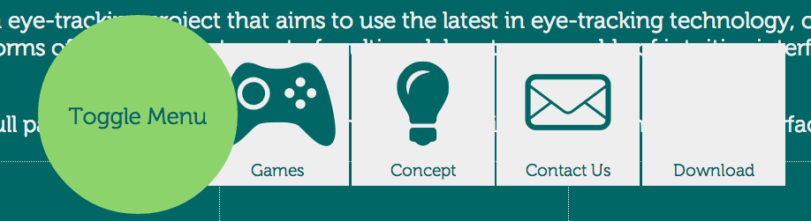
Screenshots
Notes:
Briefly talk about reason for having tabbed vs radial menu
Size difference
Speed
Left-to-right reading

Slide 17
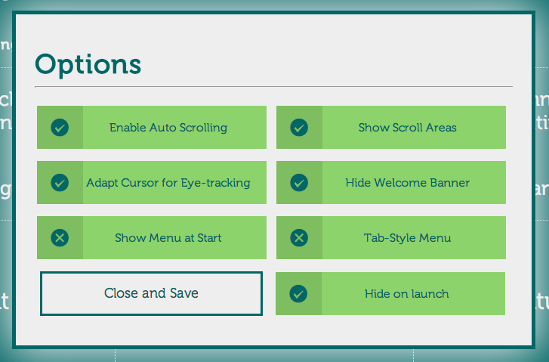
Screenshots

Slide 18

The Full Package
Research
Gestures
Console App
Website
Games
Notes:
But before we go into the live demo, let me explain the full package that I-Focus presents to you.
First, we have the core of our project, the gestures, which includes eye-tracking and various features.
But the gestures themselves are useless if they are not converted into tangible forms of input control – this is where the console app comes in.
But I-Focus takes it a step further… we give you applications in the form of a website and games. And these apps serve as a platform and interface for us to
Test out our gestures and …
Showcase how they make interface control efficient effective and intuitive
Last but not least is the component that makes us stand out from other projects – research. And it is this research that helps us to prove that eye-tracking really is…

Slide 19

Live Demo
Efficient.
Effective.
Intuitive.
Notes:
…Efficient Effective and intuitive.
Now, eyes on the screen and its your turn to be live participant.
What we will be showing you first is a game that we used in our research to see which input method is most feasible for tracking and targeting tasks.
The objective of this particular game is to pan the screen and find the full cross.
Notice the difference between a mouse and the eye-tracker.
With the mouse it’s a 3 step process (as Ryan will demonstrate)
Find the target
Move the cursor to the target
Click
But with the eye-tracker, everything is so much faster because you are literally looking to where you want the cursor to go.
All you have to do is to look at the target and click on it, just like what Ryan is doing now.
See, efficient, effective and, as our participants have said, intuitive.
[Move to website]
But I-Focus is not restricted only to targeting tasks.
We want to showcase eye-tracking for day to day applications.
Our website in particular is perfect for our target audience the physically-disabled as it is completely hands free.
So to click all the user has to do is to look at a clickable area and an animated cursor will run. (Ryan please look at the Live Demo link) and once the animation completes, a click is triggered
Now as you can see we have a radial menu for user navigation. This is a new intuitive way for users to navigate as our research as shown. (Ryan please close the menu by looking at toggle menu.)
For scrolling, we give you an even more intuitive method. By reading the last line of the page, we now you want to look on. (Ryan please look at the bottom of page)
(Ryan please scroll-up by looking at the top and then scroll down to the video)
And now for video control we know that if you look at the video, you want to watch it and if you look away for a while, it will automatically pause. (Ryan please demonstrate)
So this is the semi-telepathic power of eye-tracking!
Game (comparison)
Eye-tracking
Mouse
Website (features – for a purely hands-free interface for disabled)
Menu
Modified cursor
Auto-scroll
Video function

Slide 20
Research

Slide 21
Research Procedure
6 Live Participants
Website
Games
Notes:
We conducted an experiment on 6 live participants, all of whom were randomly chosen. Each participant was required to play a game and navigate through our website.

Slide 22
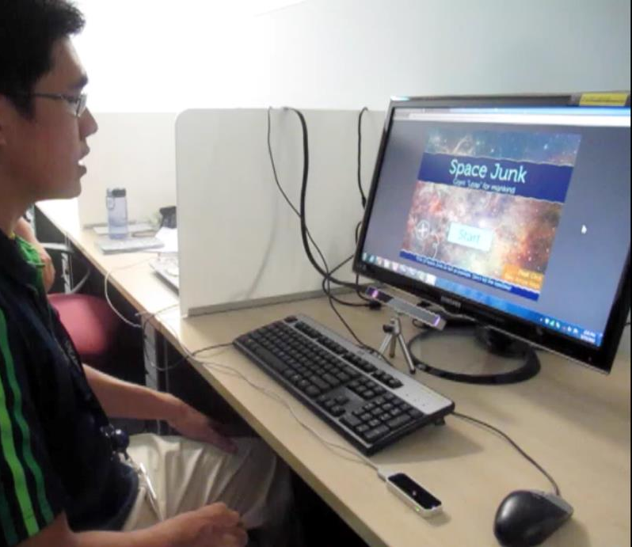
Participant
Big Screen
Eye-Tracker
Fixated Mouse
Leap Motion
Notes:
And this is our experimental set-up. There is a: ……

Slide 23
Research Procedure
Game
Website
Quantitative (Timing) + Qualitative (Survey) Data
Test suitability of input methods for tracking tasks
Eye-Tracker
Mouse
Leap Motion
Notes:
The game was played 3 times by each participant, each time having a different input method, namely eye-tracker, mouse, and leap motion. We recorded the timing participants needed to complete the game each time. We also asked them to rank the input methods according to preference.

Slide 24


Results - Game
* Less time is better.
Notes:
The game actually required participants to find 10 targets in the shortest time, so the lower the score, the better. Leap motion timings were off the charts, and all 6 participants ranked leap motion last. Also, we were pleasantly surprised to find that half the participants ranked eye-tracking to be 1st, while the other half chose the mouse, as can be seen from the icons at the top. Why is this so?

Slide 25

Comments
 | + Advantages | - Disadvantages
Eye-Tracking | Intuitive Very fast Better at targeting tasks | Jittery (inaccurate)
Leap Motion |  | Tiring Prone to errors
 | + Advantages | - Disadvantages

Slide 26
Comments - Game
Eye-Tracking
“if accurate, it is… as good (1) or better (4) than a mouse”
“It’s is pretty intuitive”
Like that they “literally get what they see”
“Quite jittery, but very fast”
Notes:
Turns out, accuracy was the main problem. Our commercial standard eye-tracker didn’t have very good accuracy. 5 participants felt that if the eye tracker had pinpoint accuracy, it would be as good as the mouse if not even better. Participants generally felt that it was pretty intuitive, and liked that they literally got what they see. Some complained of jitter, but was impressed by the speed that the eye-tracking input method could offer.

Slide 27
Comments - Game
Pure Leap Motion
Not good
“Too tiring”
“Prone to errors”
Gestures unresponsive
Accidental clicks
Notes:
Pure leap motion was not at all appealing because constantly making hand gestures was tiring and prone to errors.

Slide 28
Research Procedure
Website
Game
Questionnaire for User Interaction Satisfaction (QUIS)
Compare 2 versions of website (for hands-free vs mouse)
Interface
Selection
Cursor
Notes:
For part 2 of the experiment, each participant was also required to navigate through 2 versions of our website that differed in menu arrangement, selection method, and scrolling method. The first version was completely hands-free while the second version involved use of the mouse. After navigating through each version, participants had to complete the Questionnaire for User Interaction Satisfaction, QUIS for short – an international industry standard, which we compared to determine the preferred features for and eye-tracking interface.

Slide 29
Results - Website
* QUIS survey. Higher is better.
Notes:
These are the results, the higher the score, the better. Although the 2nd version had a better average score than the 1st, both versions seemed to be equally well-received by the participants.

Slide 30
Results - Website
Notes:
There were 3 participants who voted for each version.

Slide 31
Results - Website
Content
Most preferred radial menu as it was larger
5/6 participants preferred kinesthetic clicks
Modified cursor was considered more ineffective and too frustrating
Inaccuracy Issue
But, modified cursor scores were consistently above 5 (out of 9).
* QUIS survey used. Higher the scores, the better.
Notes:
These are some of our qualitative findings. Most preferred the radial menu as it was larger, 5 out of 6 participants preferred kinesthetic clicks as the modified cursor seemed more ineffective and frustrating since the eye-tracker is limited in terms of accuracy

Slide 32
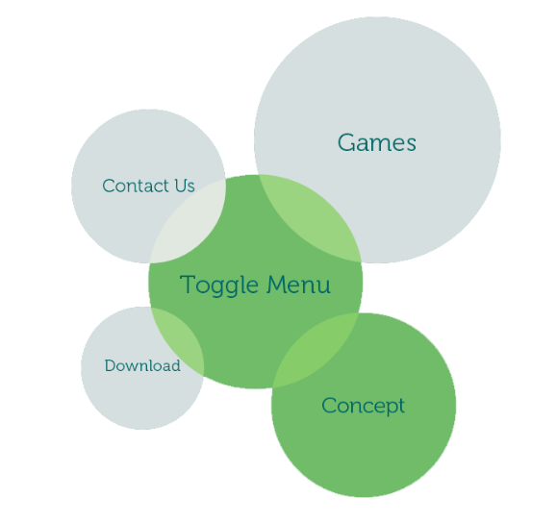
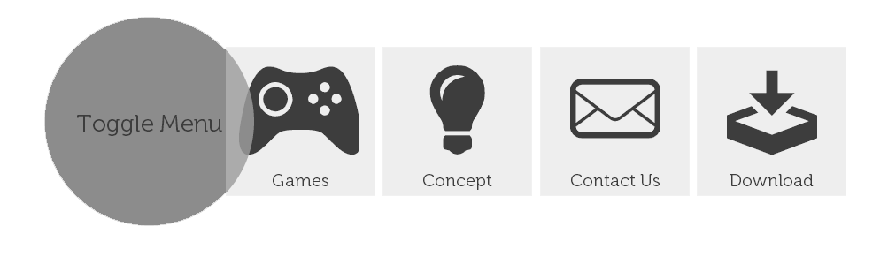
Results - Website

Slide 33
Results - Website

Slide 34
Findings - Website
Video function should
Optional
Buffer time before pause
Reduce timer
Cursor
Moving while reading is irritating
Should disappear while over text
Interface elements should
Larger
More obvious
Notes:
These are some of the changes we’ve decided to make corresponding to the research results.
[They are mainly to the video function, modified cursor, and selectable objects]

Slide 35
Summary
Once eye-tracker is accurate enough,
Eye-tracking beats the mouse in terms of…
Efficient Very Fast
Effective Targeting & Tracking tasks
Intuitive Natural
Notes:
So in the culmination of our research, it is shown that once an affordable eye-tracker with sufficient accuracy surfaces in the market, eye-tracking will beat the mouse in terms of speed and efficiency especially for targeting and tracking tasks, and have improved overall intuitiveness. There you have it, efficient, effective, intuitive. Our hypothesis proves true.

Slide 36
Looking to the Future...
Improving the Input Methods
Sound input > physical input
Improving Accuracy
Head tracking to mitigate precision
Improve Interface
Further Research
More input combination for different functions

Slide 37
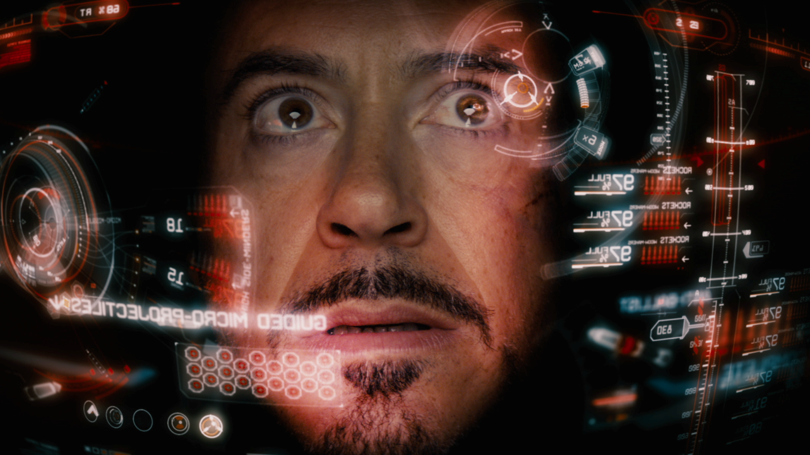
Thank You!
Notes:
“More than meets the eye”
“… in the blink of an eye”
“Look!”
“Don’t blink!”

